Slide 1

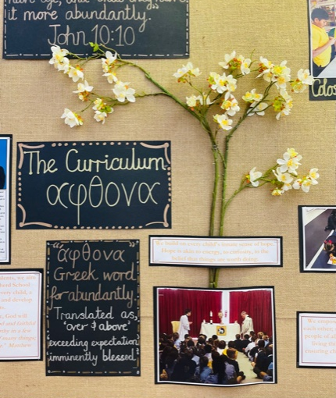
Welcome to Year 1
Curriculum Presentation
‘Growing together in God’s love and care’

Slide 2
A little bit about me
I have recently joined St Mary’s from another Catholic school in Birmingham
This is my fifth Year teaching, in which time I have taught years 1,3 and 5.
I am very confident with the Year 1 curriculum and the National curriculum.
It is a priority in my class that children feel safe and happy. This is a priority.

Slide 3
Transition from EYFS to National curriculum
It is a big change for the children but we make sure they are happy and it is a gradual process.

Slide 4
Routines
Morning - you can start to arrive from 8:35am.
Year 2 classroom doesn’t open until 8:45am.
All children should be in the class by 8:50am.
End of the school day is 3:15pm.
Children in Year 1, are expected to come to school in their PE kit and they will remain in this all day.
Please take into account the weather- children can wear grey jogging bottoms in the autumn and winter. In the summer, children wear black shorts.
PE kit days:
Wednesday and Thursdays (Autumn 1 term)
This will change in Autumn 2

Slide 5
Assessment
Assessment of each individual child’s progress is an ongoing activity throughout the day, week and term.
When children are identified as struggling with an area of learning, an adult will support them within the lesson and/or a teacher will provide a specific intervention, to help support their learning and ensure they have the confidence to keep trying.
Children will be assessed against NC learning objectives as well as individual targets set by the class teacher.
Progress will be reported to parents at 3 points during the year. In the Autumn, Spring and Summer. This will be done at parents evening. Their final report will indicate their progress and attainment for the academic year.

Slide 6
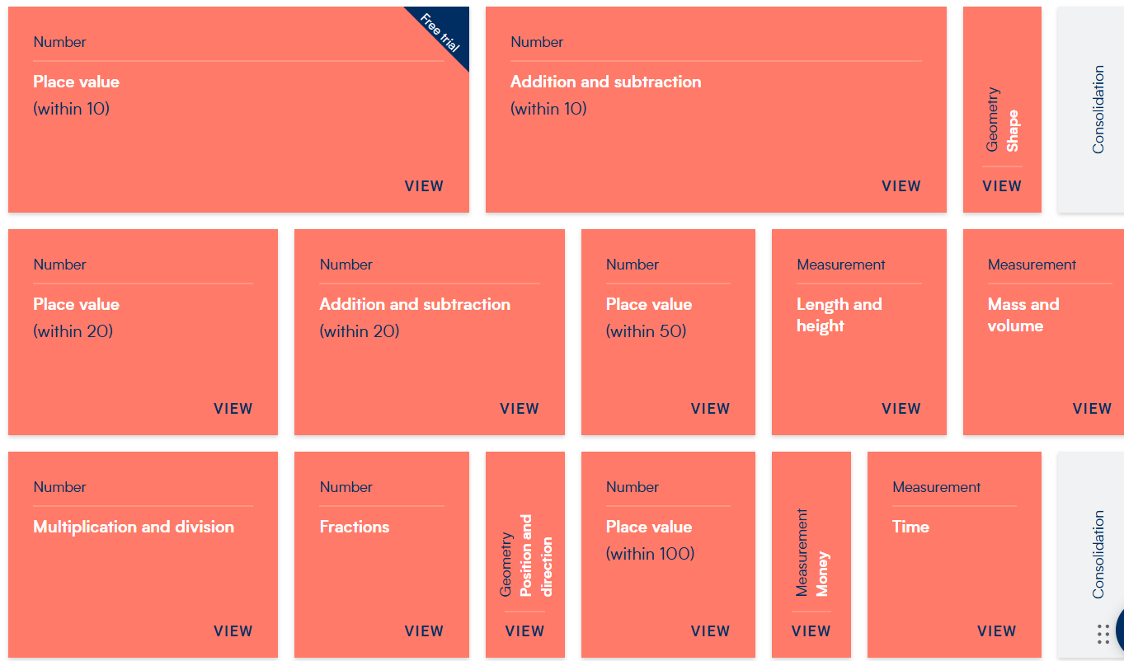
Core topics
Maths

Slide 7
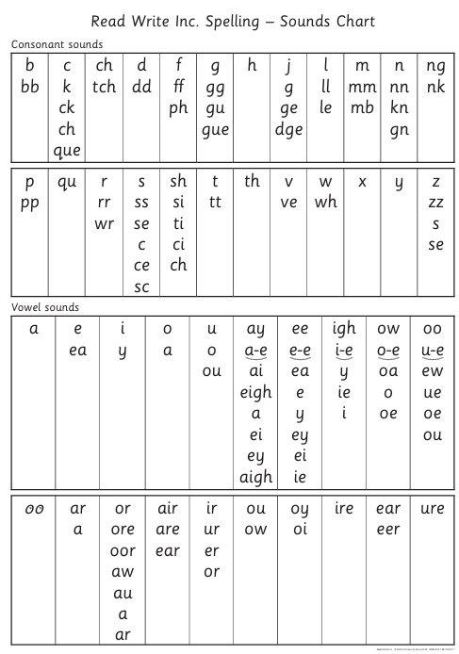

Phonics
Core topics
We follow the Read Write Inc scheme.
Children will learn a range of new diagraphs, trigraphs and split diagraphs.
We are currently assessing the children and they will be put into different phonics group beginning next week.
The children's reading book that is sent home is based on their phonics group.
Year 1 builds towards the phonics screening test in the summer term.
There will be a strong focus on reading this year in preparation to the phonics screening test.

Slide 8
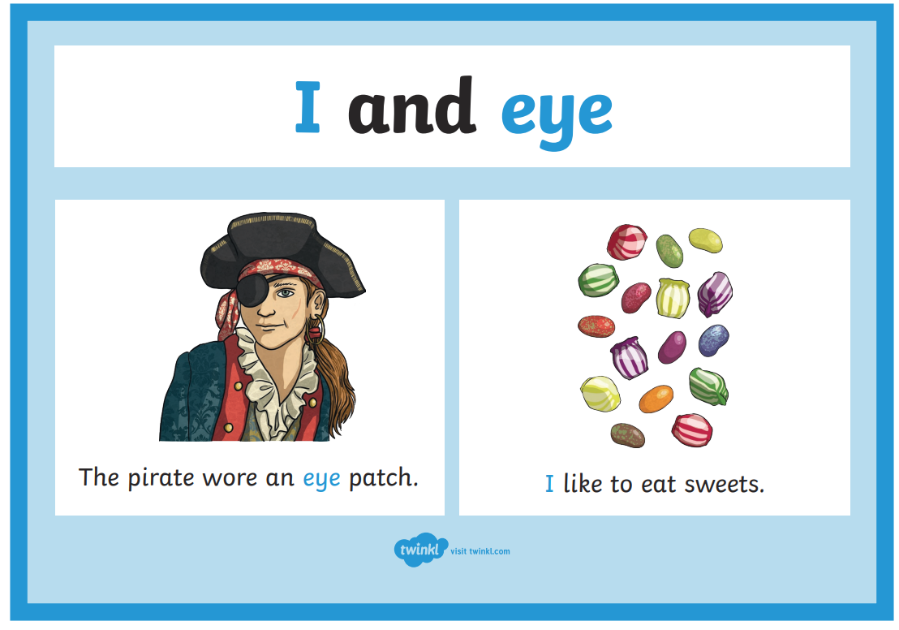
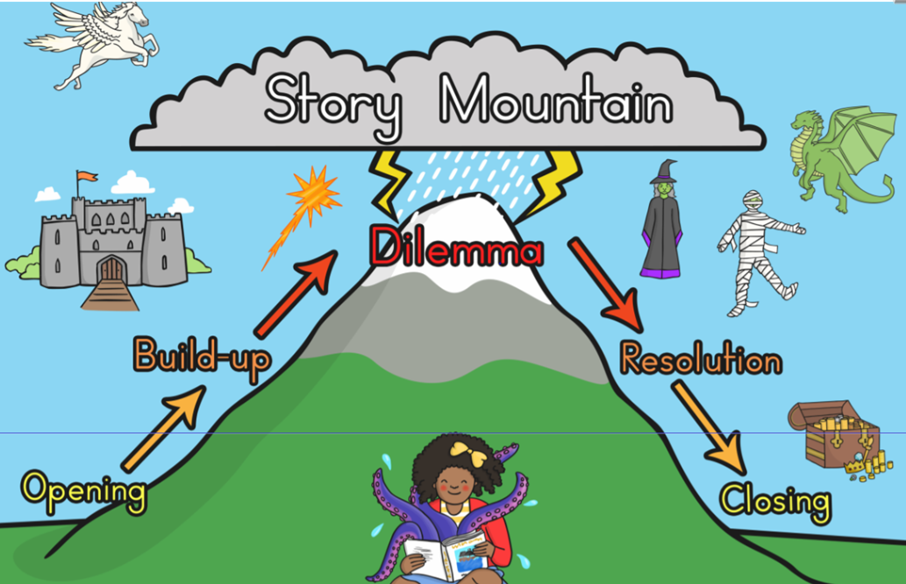
Core topics
Writing
In year 1, children should learn a range of English language and literature skills, such as:
reading and spelling KS1 common exception words
reading and spelling words with suffixes
writing simple narratives
reading and spelling homophones

Slide 9
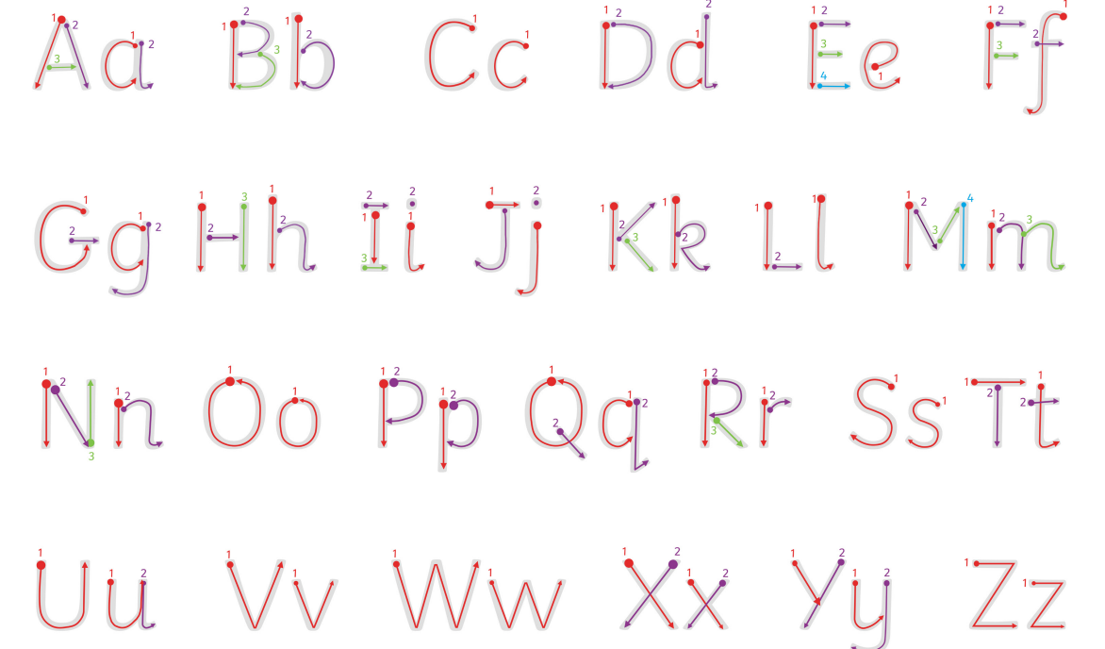

Core topics
Writing
This year there is particularly a focus on getting the children used to working in text books.
Focusing on writing on lines, letter formation etc

Slide 10
Foundation topics
History topics:
Parliament and Prime Ministers
Kings, Queen & Leaders
Discovering History
Geography
Spatial sense
The UK
The Seven continents
Science
The Human Body
Animals and their Needs
Seasons and Weather
Taking Care of the Earth
Plants
Materials and Magnets

Slide 11

Each week the children will receive 3 homework tasks.
A list of spellings to learn and write sentences with in their homework books
We will do a spelling test every Friday mornings.
The children all have an account to spelling frame so I would recommend they log in to practise their spellings each week. This will be found in their homework books this week.
A Maths worksheet
An English worksheet

Slide 12

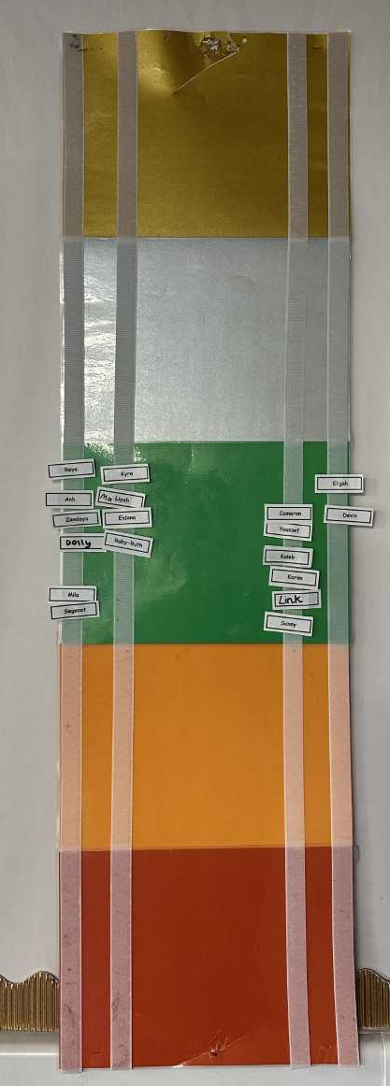
Behaviour Policy Aims:
Create a positive culture that promotes excellent behaviour, ensuring that all pupils have the opportunity to learn in a calm, safe and supportive environment.
Establish a whole-school approach to maintaining high standards of behaviour that reflect the values of the school.

Slide 13

Reading
In addition to weekly homework, your child is expected to read every evening. Reading records need to be signed by yourselves and returned to school every Friday morning. Your child will go home with a new book every Friday afternoon.
If they finish their book mid week, please encourage your child to answer lots of comprehension questions and read additional books from home.

Slide 14
Class admin
If not done so already please label your jumpers and cardigans.
Snacks- Please give your child a healthy snack, fruit, vegetables etc. The children are not allowed crisps and chocolate as a snack.

Slide 15
Communication.
I am always more than happy to speak about any worries or concerns. Mondays and Fridays are my only days I am not available after school.
If you wish to talk at the end of the day please let me dismiss first.
If you wish to email me please email the school admin email- admin@stmarysrc.lbhf.sch.uk

Slide 16
How you can support at home
Reading
Homework
Parents evening

Slide 17

Useful websites
Addition, subtraction, timetables and division:
Hit the button
J2blast
Maths Choppity Chop
Spellings
Spelling frame
Spooky spellings

Slide 18
If you have any questions now or later then please do not hesitate to ask!
I hope your child will have a positive and fun year in Year 1!

