Slide 1















Year 2
Curriculum meeting
Year 2 Miss Hankins

Slide 2
Daily Routines
Year 2 classroom doesn’t open until 8:45am.
All children should be in the class by 8:50am.
If children would like some breakfast from the tuck-shop, please ensure this is when they arrive at school and not as they are coming into class.
End of the school day is 3:15pm.

Slide 3
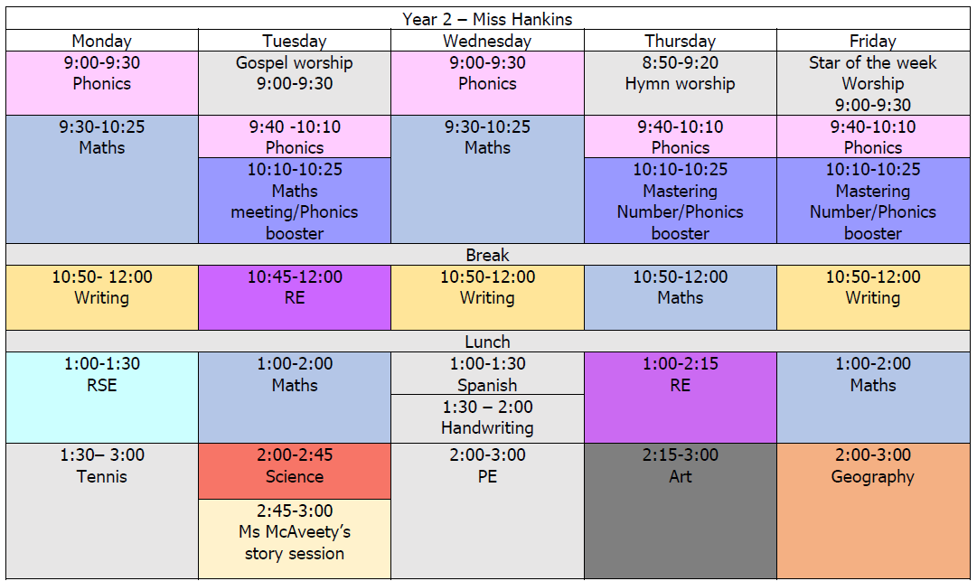
For our first half term, PE kits should be worn on Mondays and Wednesdays.

Slide 4
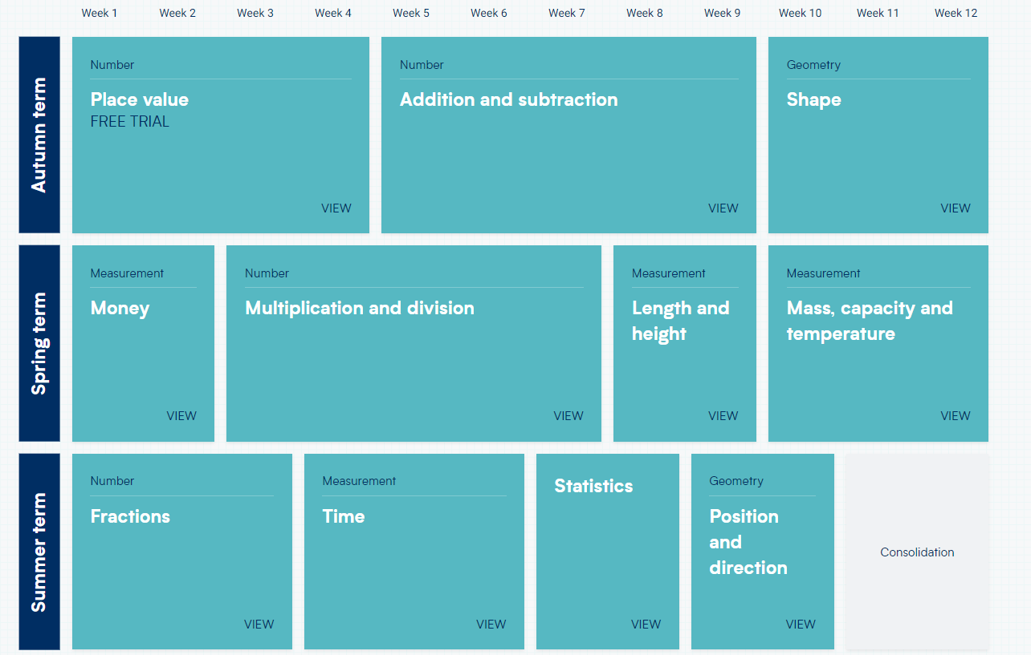
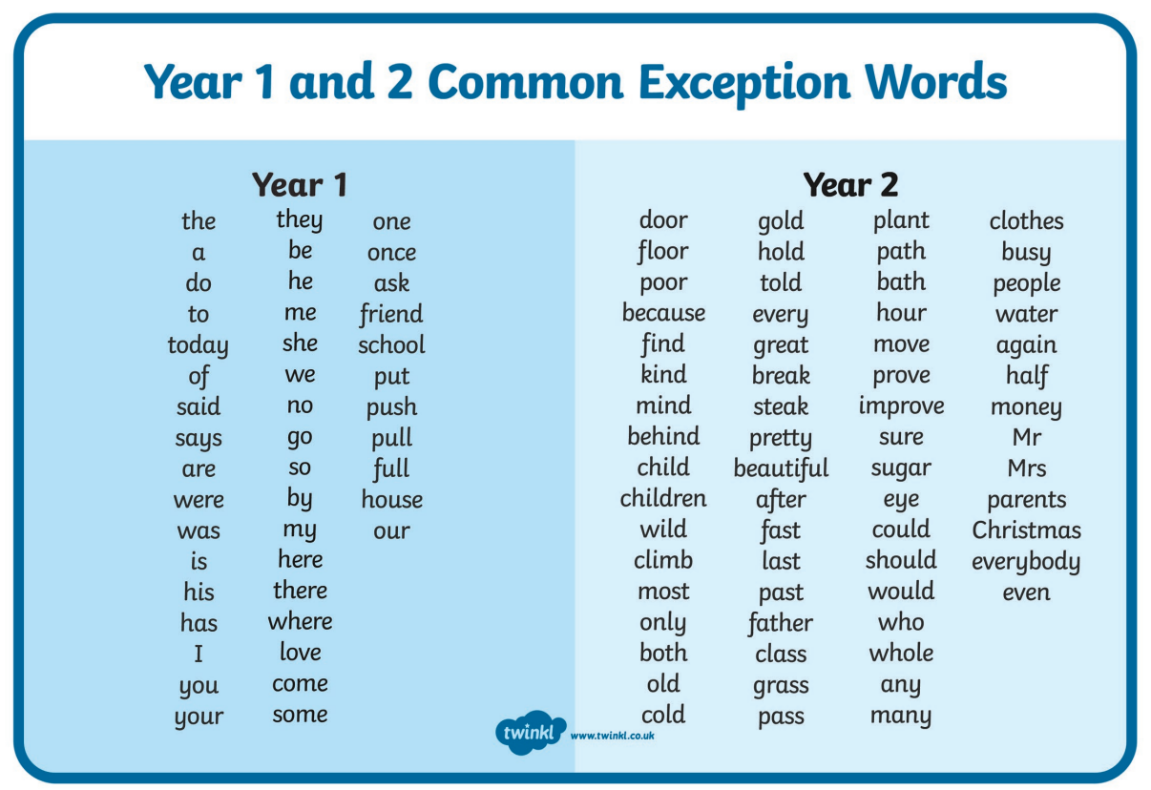
Core subjects
Maths:
- Timestables
End of unit assessment
Termly assessments
Writing:
Word classes
Common exception words
Punctuation
Handwriting

Slide 5
reading
In addition to weekly homework, the children will be given a book to read through the week.
Daily reading will help them with independence and encourages them to extend their vocabulary.
Reading records need to be signed by yourselves and returned to school every Friday morning.
Phonics to shared reading transition
Phonics resits

Slide 6
FOUNDATION SUBJECTS
history
Geography
Science
Charles II: Plague and Fire
The Victorians
The First Olympics
Spatial sense
The British Isles
Mediterranean Europe
  The Human Body
  Materials and Matter
  Astronomy
  Plants
  Living things and their environments

Slide 7
Homework
Each week the children will receive 4 homework tasks. Sent out Friday. Due following Thursday.
A list of spellings to learn, We will do a spelling test every Friday morning.
A times table activity to help them learn their times tables off by heart
A Maths worksheet
An English worksheet
Their login information for Spelling frame and Timetable Rockstars will be stapled to their reading record for the children to easily locate.

Slide 8
Assessment- SATS
SATS completed at the end of June
2x maths, 2x reading, 1x spelling and 1x SPaG
More frequent testing for practice as the time comes
This is for our data to assess them after their time in KS1
Parents are informed of the results on their end of year report.

Slide 9
Important points
Independence through the year
Behaviour expectations: chart, dojos
Prayer book
Uniform

Slide 10
Thank you for listening!
- If you have any questions please do let me know. Either at the door or through the admin email: admin@stmarysrc.lbhf.sch.uk

Slide 11
THANK
YOU

