Slide 1

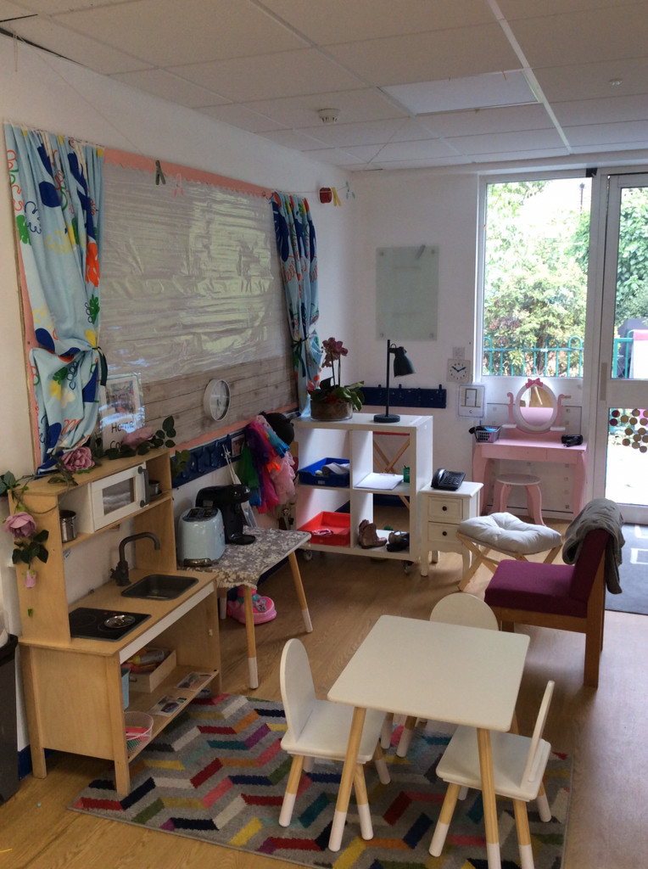
Welcome to NURSERY
Curriculum Presentation
‘Growing together in God’s love and care’

Slide 2
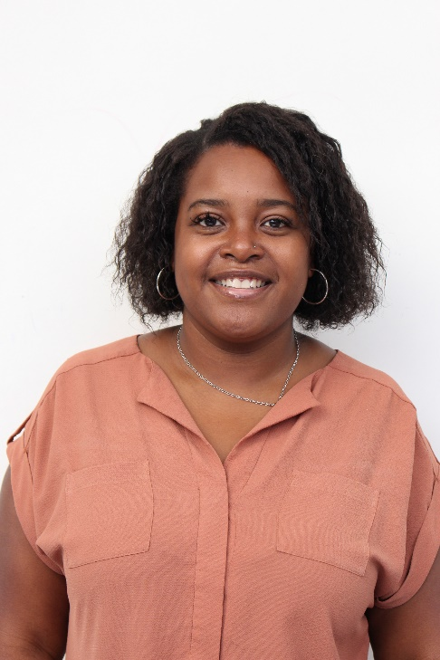
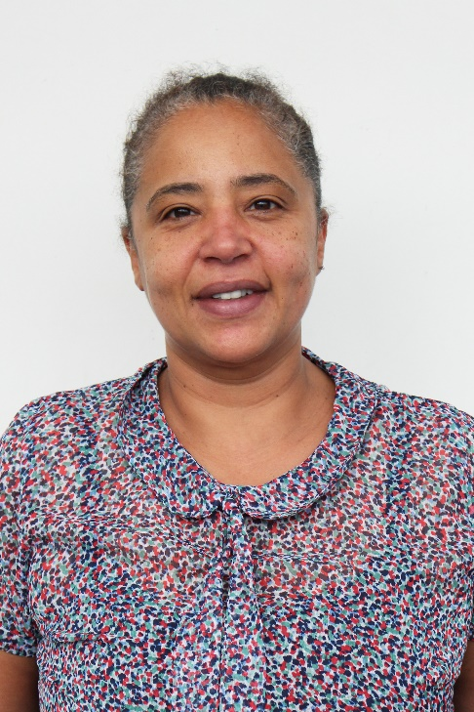
Nursery class Teacher TEACHING assistant
NURSERY STAFF
Miss Myers
Miss Sylvie

Slide 3
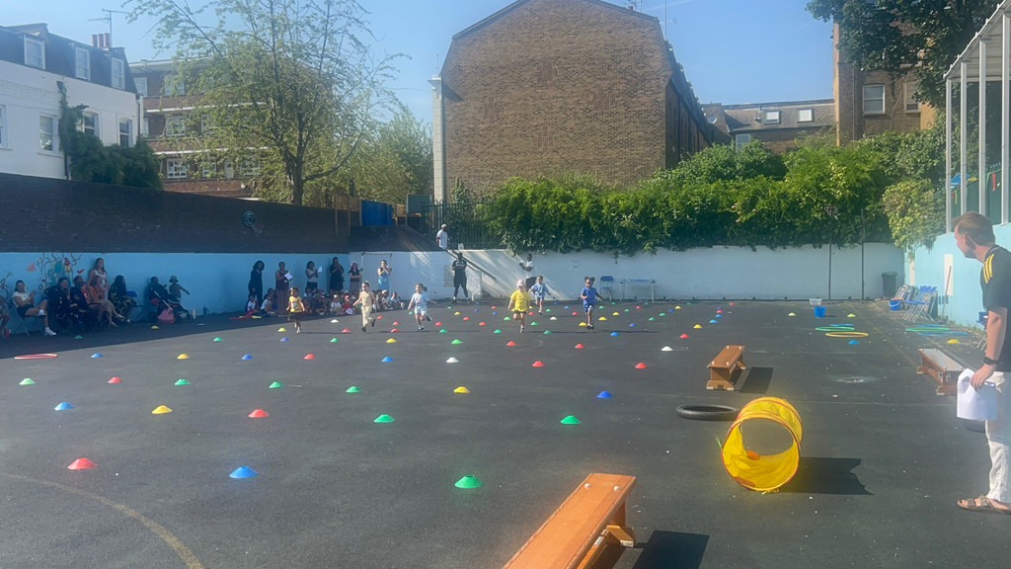
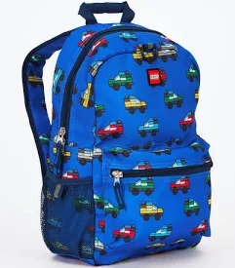
Routines
Nursery classroom opens at 8:45am.
All children should be in the class by 8:50am.
End of the school day is 3:00pm.
Children who arrive after 8:50am will be marked in as late.
Nursery children come in and hang up their own bags and coats on their pegs. They then wash their hands in the toilets and then make their way to the carpet area to self-register and sit down.
PE days:
Thursday is PE in the big playground with a coach (Extra-Curricular)
Children need to bring in a rucksack with spare
Clothes and a packet of wipes.

Slide 4

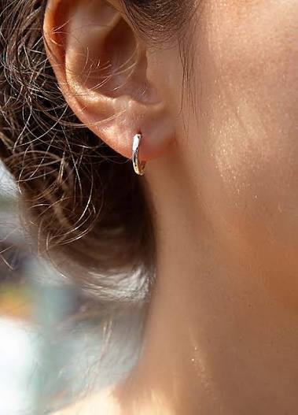
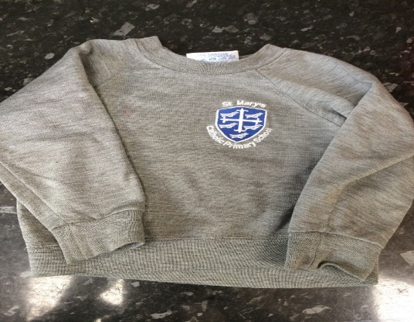

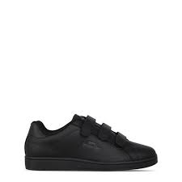
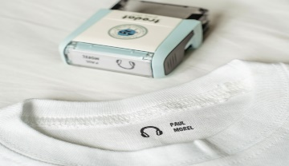
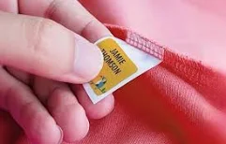
Uniform
During the summer term, children should wear:
A grey school jumper with or without the school logo
Plain black shorts
A plain white T-shirt
During the winter months, plain grey joggers should be worn instead of black shorts.
The remaining uniform items can be purchased from a range of high-street retailers, including Primark, ASDA, Next, H&M, and other similar stores. Please ensure that all items are plain, practical and appropriate for nursery, allowing children to move comfortably and participate fully in daily activities.
Children are allowed to wear stud earrings. No hoops.
All children must wear Velcro strap trainers (NO LACES)
PLEASE LABEL ALL ITEMS OF COTHING

Slide 5
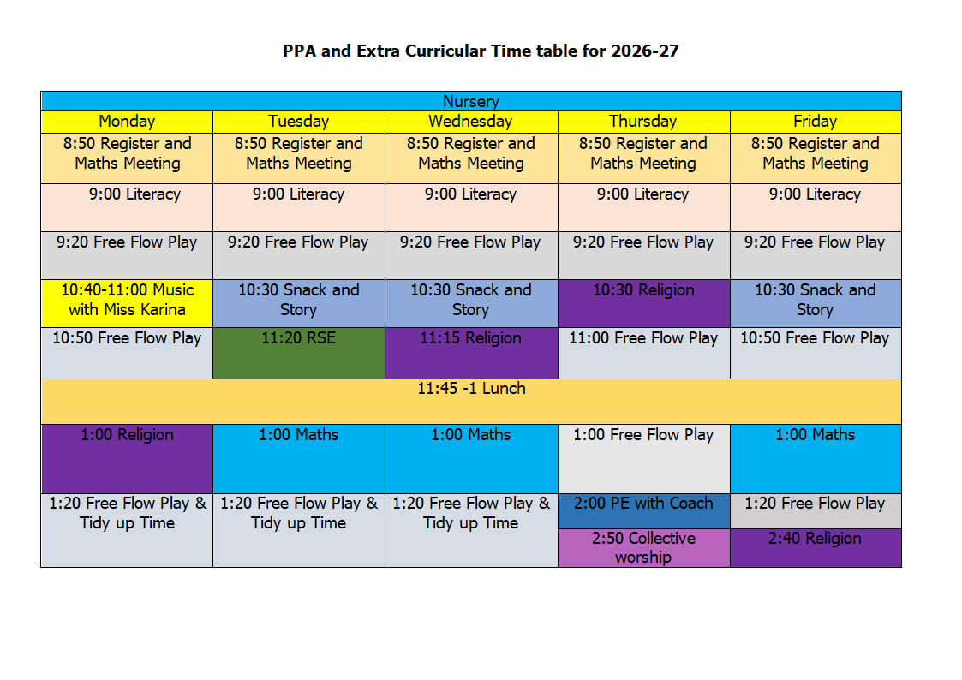
NURSERY TIMETABLE

Slide 6
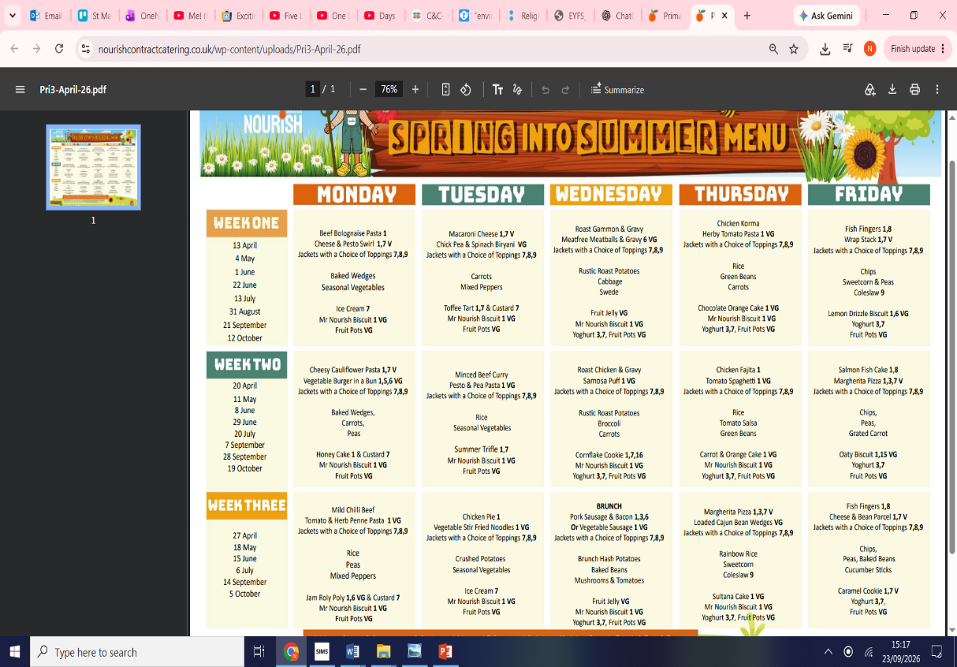
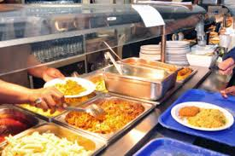
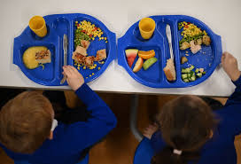
Nourish
Nourish is a privately owned, family-run contract catering company, providing high-quality meal services to schools in the UK and Ireland. They believe the use of good quality ingredients in homemade cooking is the real recipe for success. The Nourish team work with chefs in the kitchens and children in the classroom to develop new meals that everyone will enjoy.
https://www.nourishcontractcatering.co.uk/

Slide 7

Assessment
Assessment of each individual child’s progress is an ongoing activity throughout the day, week and term. We use tapestry to record these.
When children are identified as struggling with an area of learning, an adult will support them within the lesson and/or a teacher will provide a specific intervention, to help support their learning and ensure they have the confidence to keep trying.
Children will be assessed against EYFS Developmental Matters Statements learning objectives as well as individual targets set by the class teacher.

Slide 8
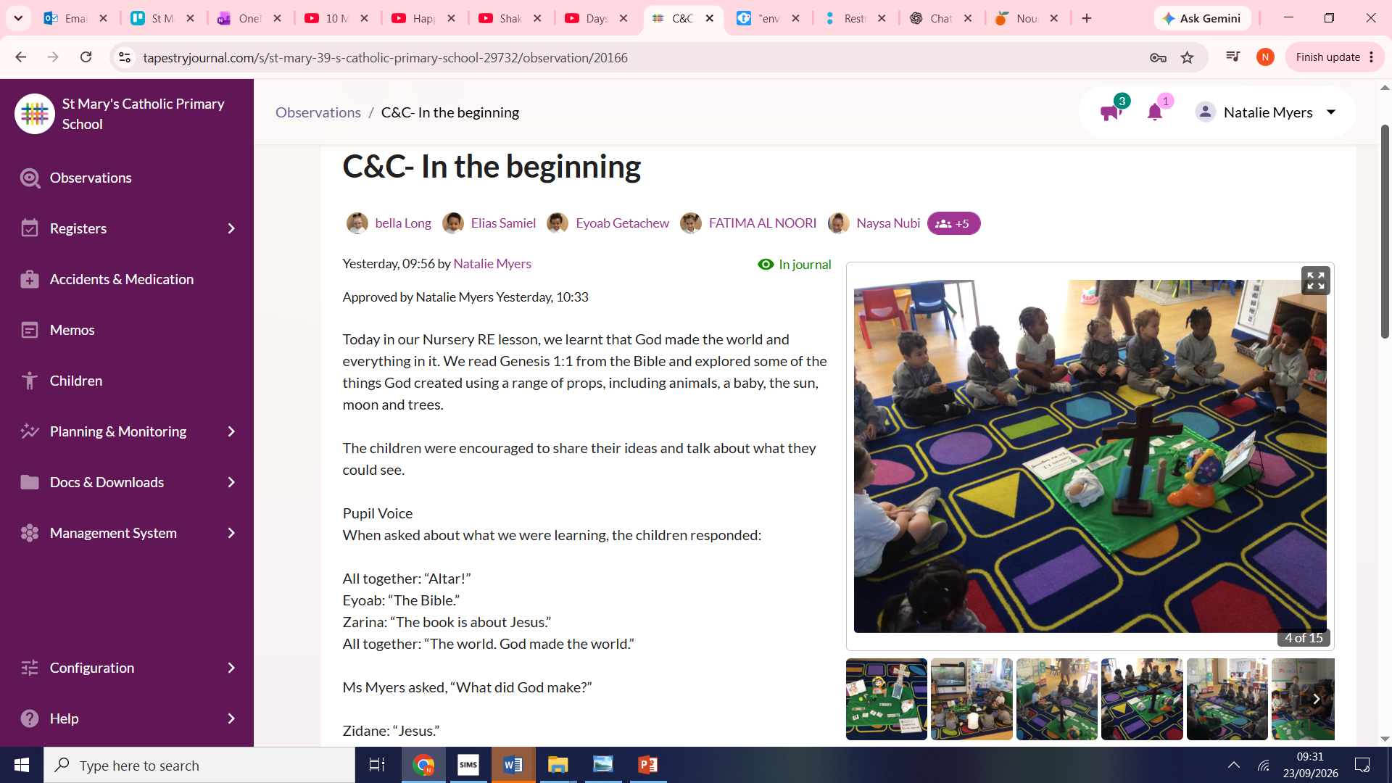

Slide 9
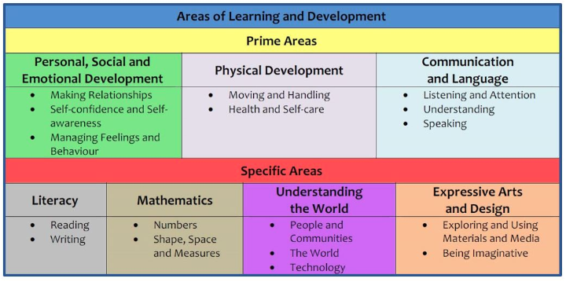
Early years curriculum

Slide 10
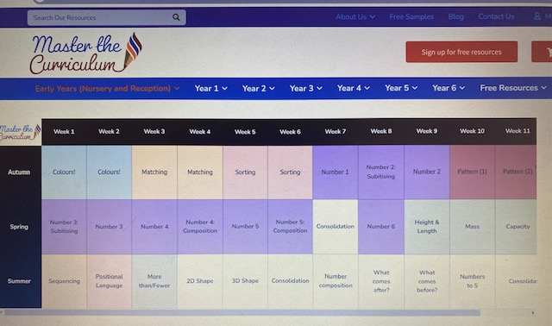
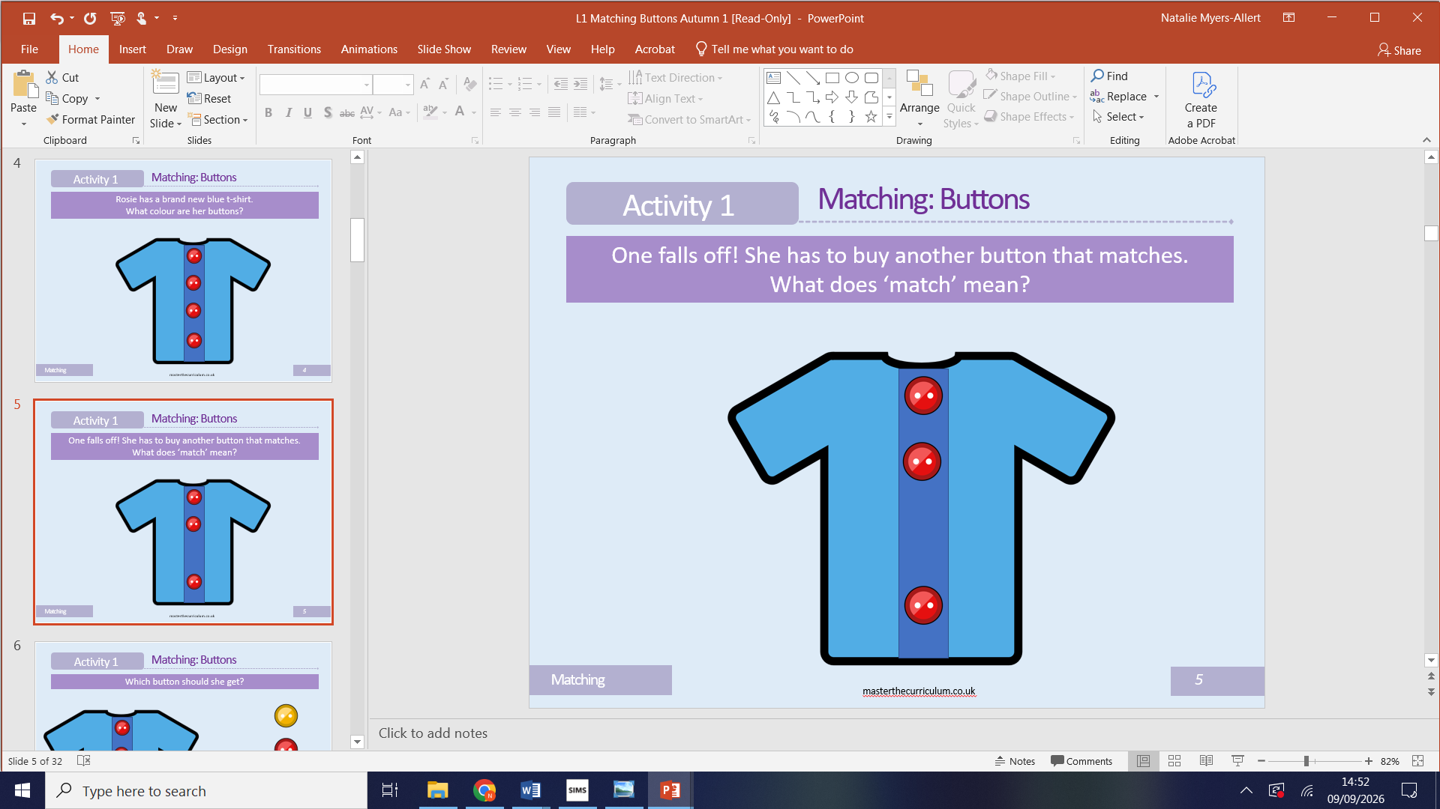
Maths
In maths we use the master the curriculum framework, the children participate as a whole class then to consolidate their learning they sit 1-1 with a teacher and complete a small task relating to what they have just learnt.

Slide 11
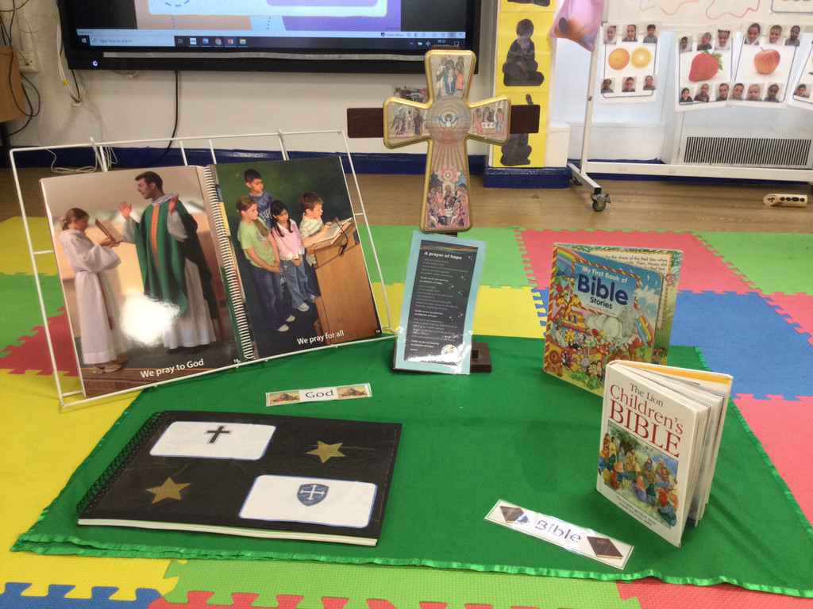
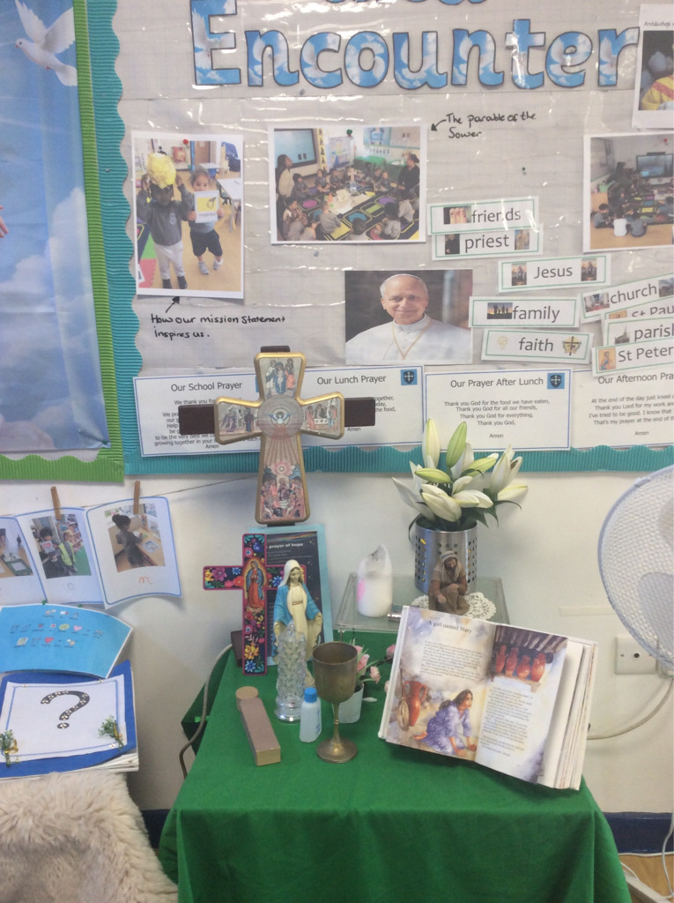
Religious Education
As a Catholic school, Religious Education (RE) is an important part of daily life in our Nursery. RE is taught every day and is naturally woven throughout both our indoor and outdoor provision, allowing children to develop their understanding of faith through a range of meaningful experiences.
We follow the RED (Religious Education Directory) framework, with a different focus and theme explored each half term. This term, our focus is Creation and Covenant, where the children will begin to explore God's creation and our relationship with God.
Children will learn through listening to carefully chosen Bible stories and stories shared on the interactive board. We create a special and reverent space within the classroom, with an altar set up on the carpet where we gather together to listen, talk, pray and reflect.
Learning will also be supported through role play, songs, prayer, discussion and practical experiences. The children will have opportunities to explore their understanding through both adult-led activities and child-initiated play.
As part of our links with our parish community, we will visit our local church, Holy Trinity, throughout the year. Father Richard will also visit the children, helping them to develop an understanding of the church and the people who are part of our Catholic community.
All RE teaching and experiences will be reverent, nurturing and appropriate to the children's age and stage of development, enabling our youngest children to encounter and explore their faith in a joyful and meaningful way.

Slide 12

Read Write Inc Phonics
In the Nursery class we follow a programme called Read Write Inc.
We will teach 1 sound a week and will start in Autumn 2 after Phase 1 phonics.
https://www.youtube.com/watch?v=pdBCtI3G1Lc

Slide 13

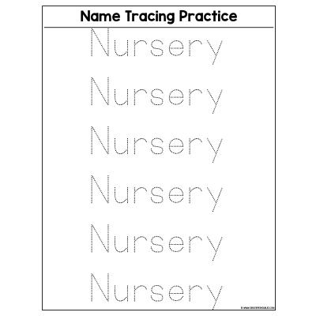
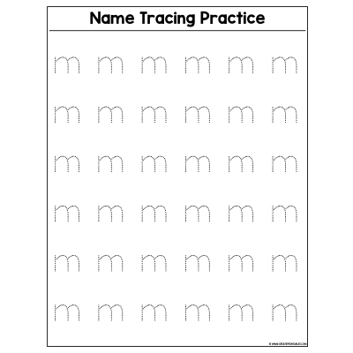
Children will be giving homework on Friday’s which will need to be returned on Monday morning.

Slide 14
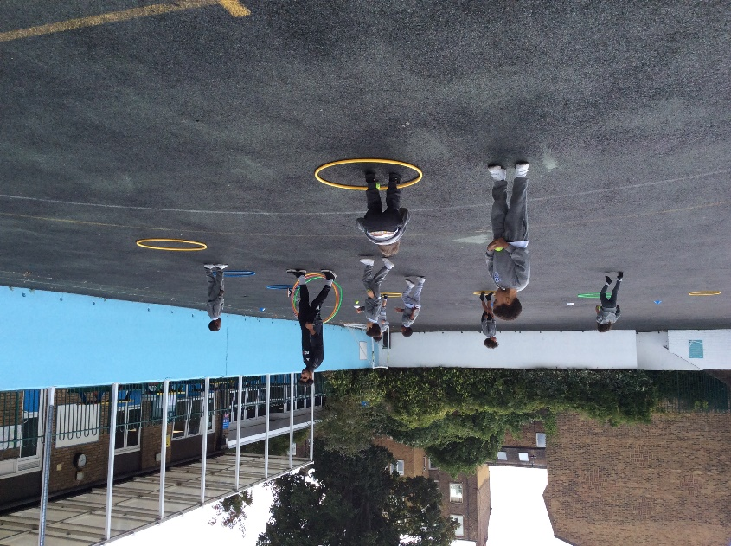

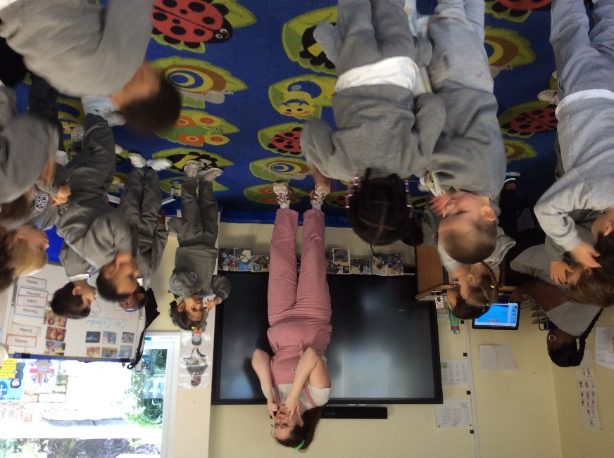

Extra curricular activities
Music
PE

Slide 15


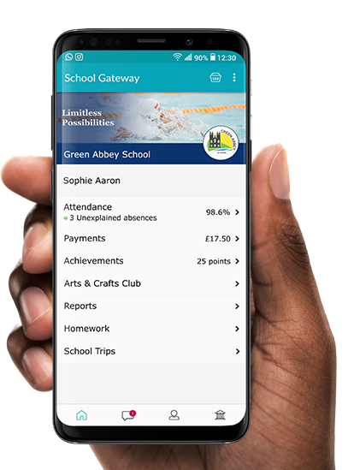
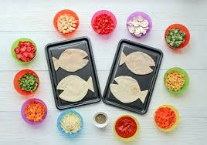
Cooking in Nursery
In nursery the children participate in cooking. This will be each Friday and will relate to the theme/topic the children are learning. We ask for £5 every half term per child to contribute towards this, this can be paid using the school gateway app.

Slide 16

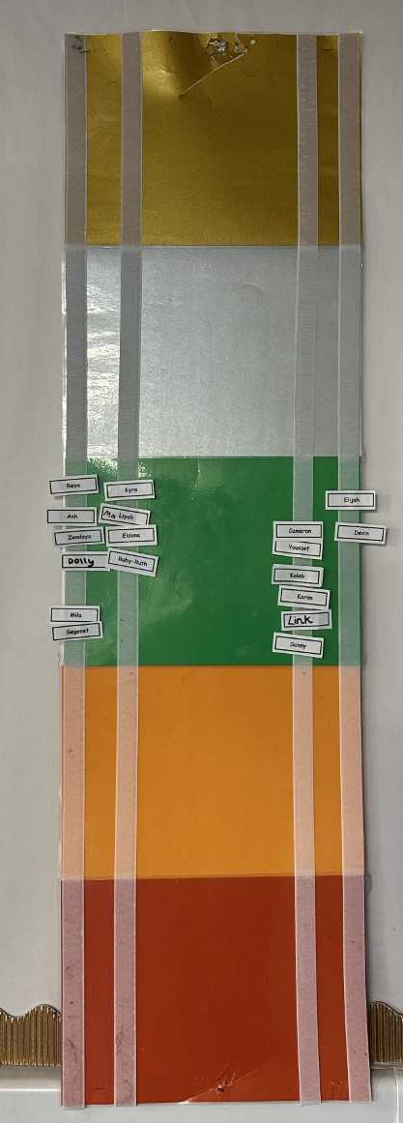
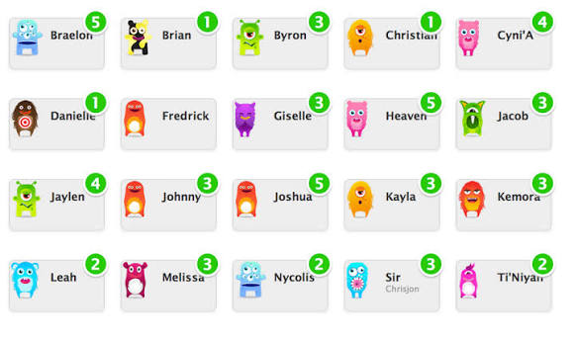
Behaviour Policy Aims:
Create a positive culture that promotes excellent behaviour, ensuring that all pupils have the opportunity to learn in a calm, safe and supportive environment.
Establish a whole-school approach to maintaining high standards of behaviour that reflect the values of the school.
Dojo points
Dojo Points are used to encourage and recognise positive behaviour and learning in our Nursery class. Children can earn points for things such as being kind and helpful, listening well, joining in activities, showing good manners, trying their best, and making positive choices. The points help children develop confidence, independence and a positive attitude towards learning.

Slide 17
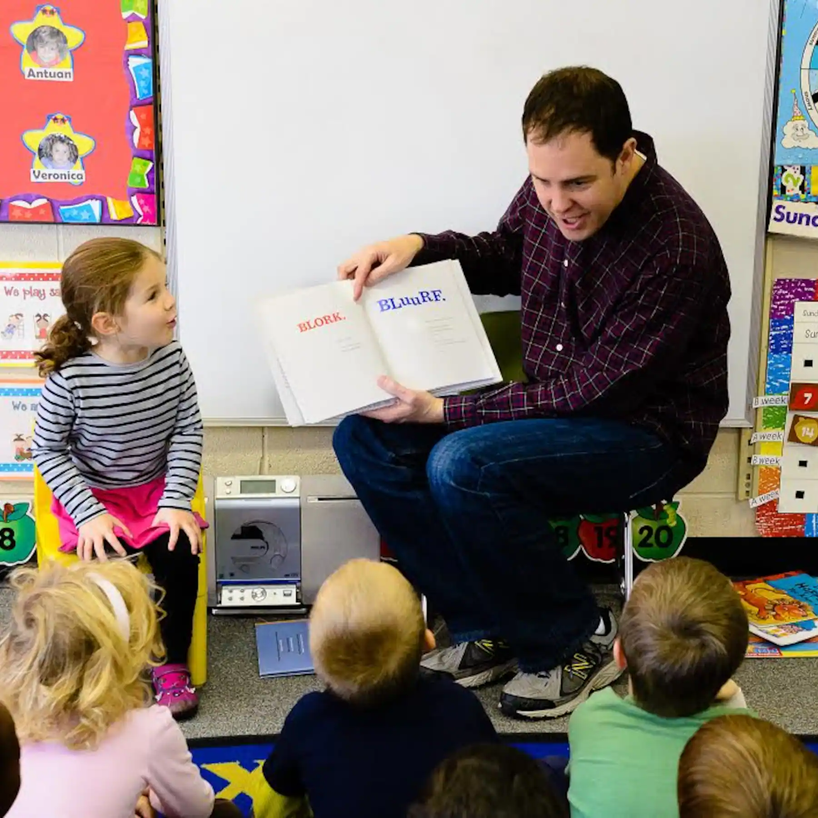
Topic
The topic for this half term is ‘All about me’. Please can you email the school office a picture of your child and a small blurb of your child’s heritage and languages they speak. This will be added to our topic board in the classroom. Email: admin@stmarysrc.lbhf.sch.uk
We would also love to have parents volunteer to read a story to the children in different languages throughout the school year.

Slide 18



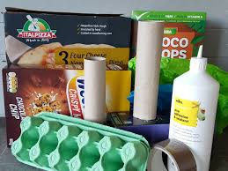
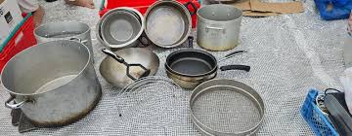
Donations
In Nursery we are always looking for donations, every little helps. We thank you in advance!

Slide 19
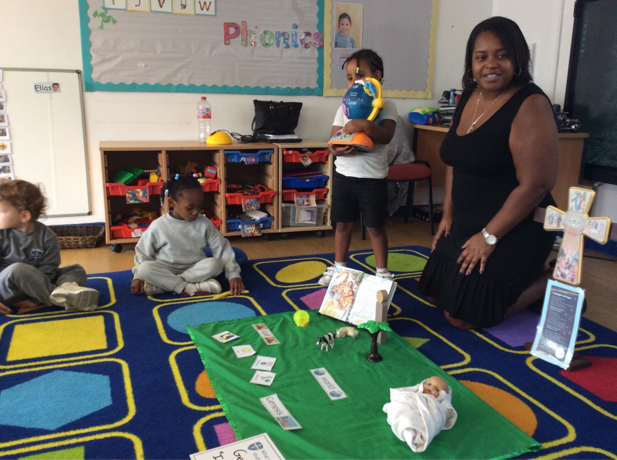
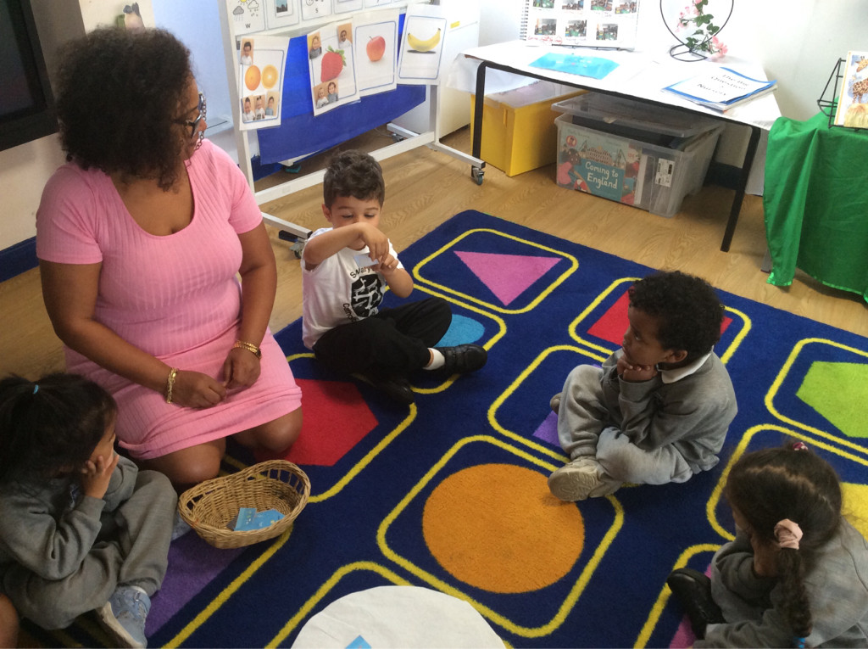
If you have any questions now or later then please do not hesitate to ask or email the school.
I hope your child will have a positive and fun year in Nursery.
Email: admin@stmarysrc.lbhf.sch.uk

